Slide 1
AI Textbook Q&A System
A RAG-Based Educational Question Answering System with Deep Source Tracing & ROS 2 Voice Integration
Hye Ran Yoo (041145212) | Peng Wang (041107730)
CST8507: Natural Language Processing April 3, 2026
Part 1: RAG Pipeline
Part 2: ROS 2 Voice

Slide 2
Agenda
Part 1: RAG Pipeline
1. Introduction & Motivation
2. Dataset (46 Textbooks)
3. Preprocessing Pipeline
4. Hybrid Retrieval Architecture
5. Deep Source Tracing
6. Streamlit UI Demo
7. Evaluation (20 Questions)
Part 2: ROS 2 Integration
8. ROS 2 Architecture (5 Nodes)
9. Implementation Details
10. Live Demo
Wrap-Up
11. Challenges & Solutions
12. Discussion & Future Work

Slide 3
1. Introduction & Motivation
Problem > Goal > Our Solution
PROBLEM
GOAL
SOLUTION
Students face 46+ AI/ML textbooks
Hard to navigate across books
No unified search system
No way to verify answer sources
Ask natural language questions
Get accurate, sourced answers
Deep source tracing:
Book > Chapter > Page > Region
Click to see original PDF
RAG pipeline with 4 retrievers
RRF fusion for ranking
Ollama LLM (qwen2.5:0.5b)
Streamlit UI + PDF viewer
ROS 2 voice integration
Research Question: How can we build a transparent, traceable educational Q&A system for AI/ML learning?

Slide 4
2. Dataset - 46 AI/ML Textbooks
Curated collection of canonical educational resources
Machine Learning (8 books)
NLP (4 books)
Mathematics (5 books)
Vision / RL (3 books)
Programming (5+ books)
ISLR, ESL, PRML PML, Deep Learning
SLP3, Eisenstein Manning IR
MML, Boyd MacKay, Snell
Szeliski, Sutton & Barto, GRL
Fluent Python Clean Code, DDIA
46 BOOKS | 85,356 CHUNKS | ~500MB PDFs | Open-access / educational copies
Preprocessing Pipeline
MinerU (DocLayout-YOLO)
Layout Analysis
Text/Table/ Formula Extract
Intelligent Chunking
Dual Indexing

Slide 5
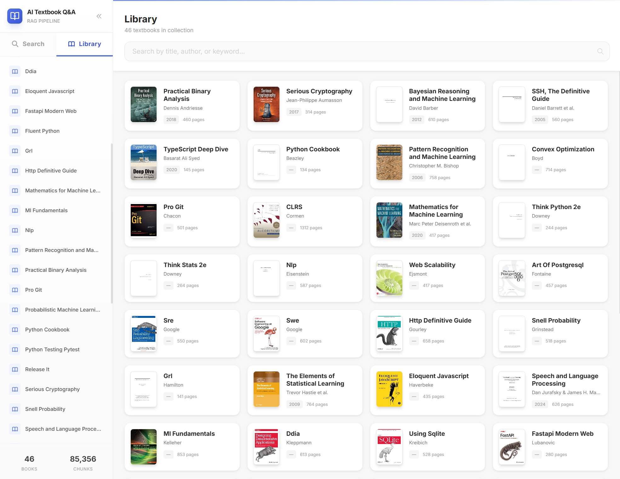
2. Dataset - Library View
Browse all 46 textbooks
with cover art, author, and page count

Slide 6
3. RAG Architecture
4-Method Hybrid Retrieval + Reciprocal Rank Fusion
1. BM25 Keyword (SQLite FTS5)
User Query (Natural Language)
RRF Fusion (Reciprocal Rank Fusion)
Ollama LLM qwen2.5:0.5b (~0.4 GB RAM)
Answer + Source Tracing
2. Semantic Vector (ChromaDB + MiniLM)
3. TOC Tree (LLM Reasoning)
4. Metadata Filter (Structured)
BM25: Fast exact keyword matching via SQLite FTS5 extension
Semantic: Embedding-based retrieval with all-MiniLM-L6-v2 + ChromaDB
TOC Tree: Hierarchical TOC navigation using LLM reasoning per book
Metadata: Structured filtering by book, chapter, page, content type

Slide 7
4. Key Feature - Deep Source Tracing
Not just citations - pixel-level traceability to original documents
User asks: "What is SVM?"
RAG retrieves from 46 textbooks
Answer generated with source refs
Click source -> Original PDF page
Highlighted bounding box
What makes this different from basic RAG?
Standard RAG: "According to textbook X, SVM is..."
Our system: Click "View PDF (p.354)" -> opens original page with yellow highlight
Each chunk stores: book_title, chapter, page_number, bounding_box (x, y, w, h)
MinerU (DocLayout-YOLO) extracts spatial coordinates during preprocessing
Enables instant visual verification against original source material

Slide 8
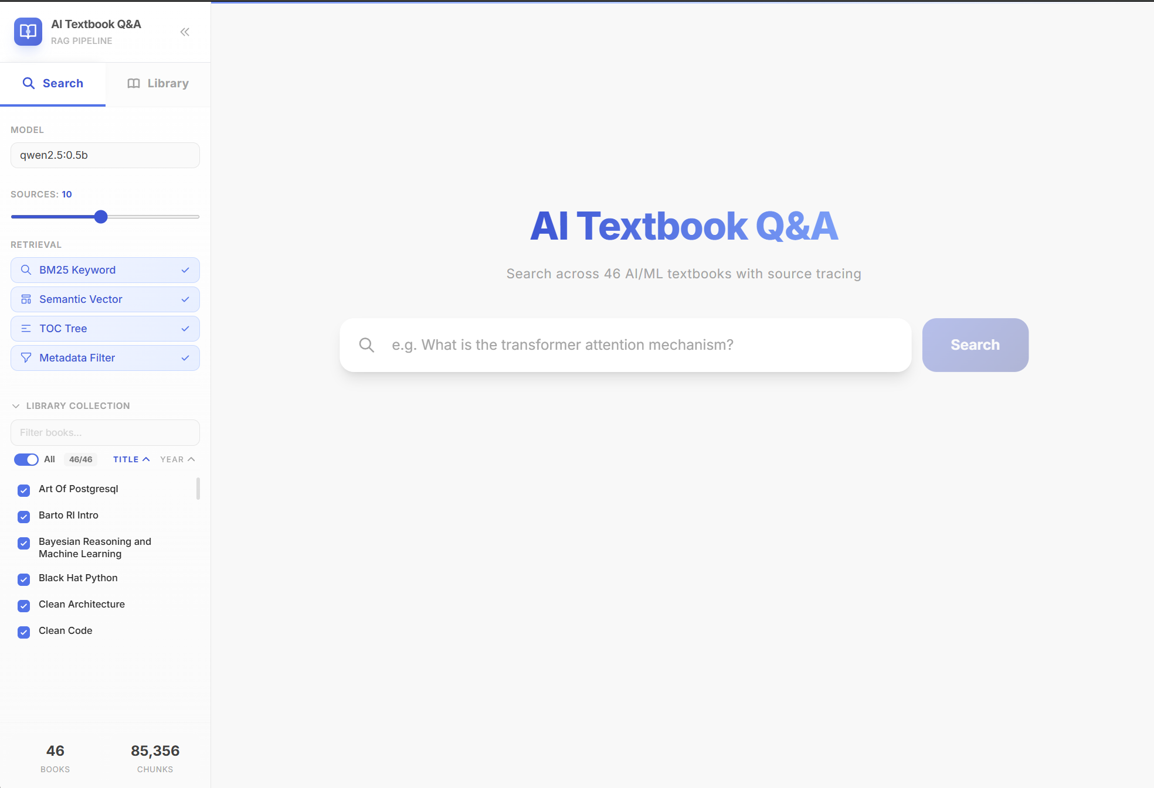
5. Streamlit UI - Search Interface

Slide 9
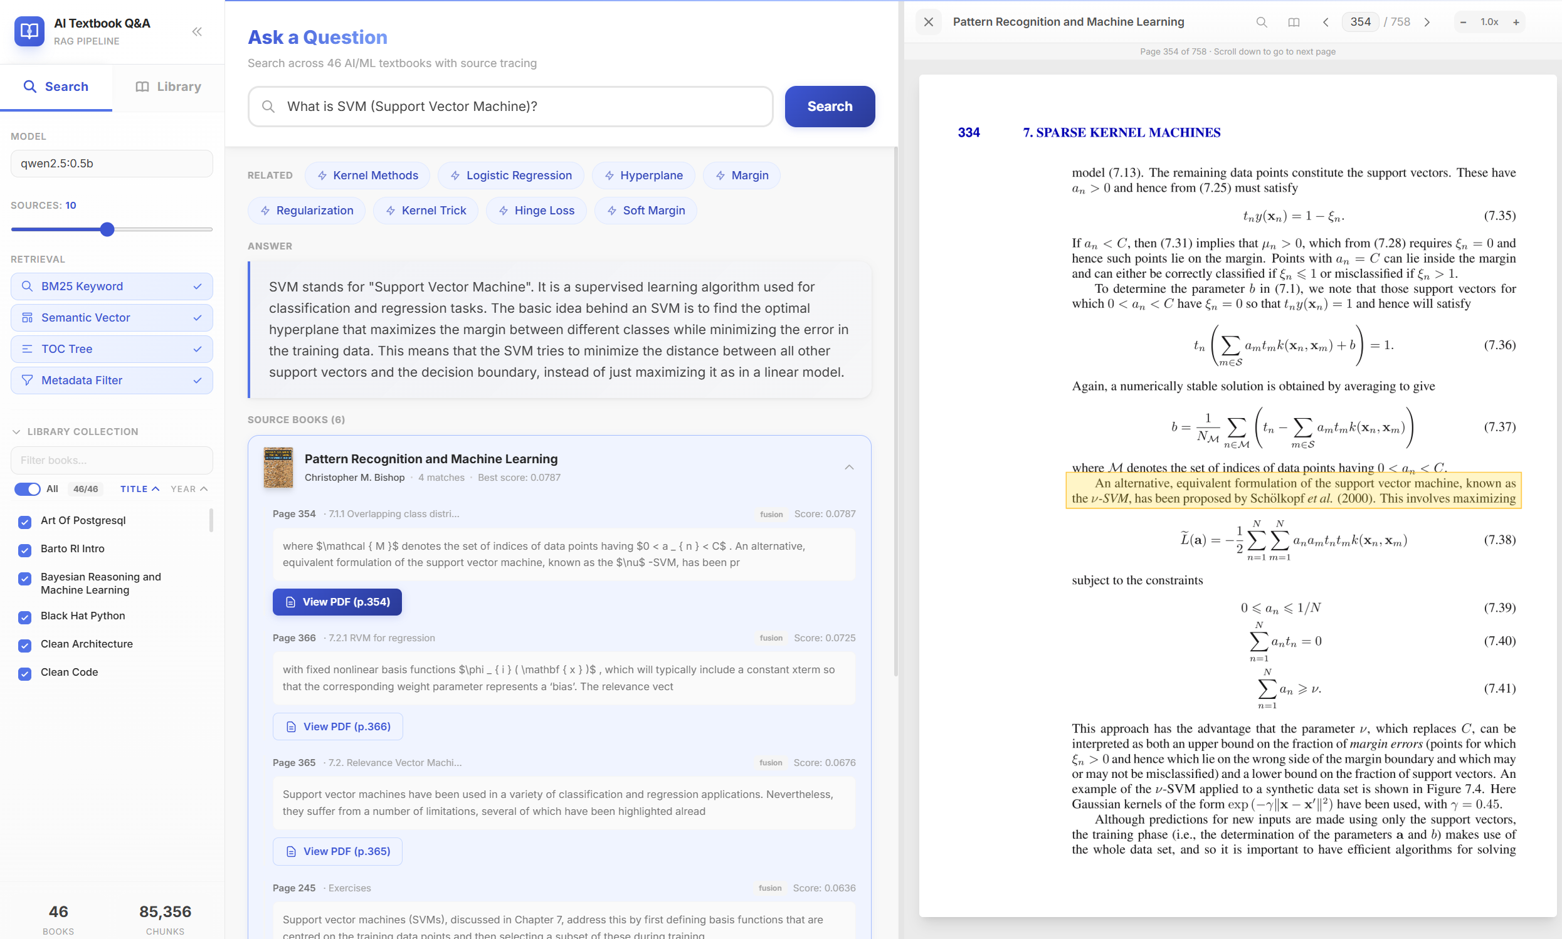
5. Streamlit UI - Results & PDF Viewer

Slide 10
5. Streamlit UI - Feature Details
All features of the interactive search interface
Search Features
PDF Viewer Features
4 retrieval methods with individual toggles
Adjustable top-K sources (1-20 slider)
Library collection filter (select books)
Model selector (qwen2.5:0.5b)
Related topic tag suggestions
Answer with full-text generation
Source documents with relevance scores
Click "View PDF" -> opens inline viewer
Page navigation (prev/next, page input)
Zoom controls (fit width, zoom in/out)
One-page / two-page spread mode
Highlighted source region (yellow bbox)
Full-screen viewing mode
Scroll to navigate through pages
Tech: Streamlit + FastAPI backend + SQLite FTS5 + ChromaDB + Ollama + MuPDF

Slide 11
6. Evaluation - 20 Test Questions
Manual assessment across AI/ML/NLP domains
Scoring Method
20 Test Questions
1.0 = Correct answer with relevant sources
0.5 = Partially correct / incomplete
0.0 = Incorrect or irrelevant
Each question: top 3 retrieved documents
Relevance marked for each source chunk
Final accuracy = mean score across 20 Qs
1. What is neural attention?
2. Generative vs discriminative?
3. Gradient for logistic regression?
4. What is an N-gram LM?
5. What is skip-gram?
6. RNNs as language models?
7. 3D rigid body transformation?
8. Weight initialization?
9. Network depth?
10. Cost-sensitive classification?
11. What is TF-IDF?
12. What is backpropagation?
13. Transformer architecture?
14. What is Word2Vec?
15. Named Entity Recognition?
16. What is beam search?
17. Dropout regularization?
18. Batch normalization?
19. What is transfer learning?
20. What is BLEU score?
Target accuracy: >80% | Domains: ML, NLP, CV, Math, Deep Learning

Slide 12
Part 2
ROS 2 Voice Integration
Converting the RAG pipeline into a voice-interactive system using ROS 2 Humble on Ubuntu 22.04

Slide 13
7. ROS 2 Architecture - 5-Node Pipeline
Voice input -> STT -> RAG -> TTS -> Voice output
1/5 MICROPHONE RecordingPublisher
2/5 WHISPER STT WordsPublisher
3/5 RAG + LLM OllamaPublisher
4/5 SPEAKER SpeakClient
5/5 TTS ENGINE SpeakService
/recording
/words
/ollama_reply
/speak (srv)
aisd_hearing package (our code)
aisd_speaking (provided)
Node Details:
1. RecordingPublisher: Mic input + Silero VAD
2. WordsPublisher: faster-whisper (int8, auto-lang)
3. OllamaPublisher: RAG + qwen2.5:0.5b (our node)
4. SpeakClient: Receives reply, calls TTS service
5. SpeakService: gTTS -> audio playback
Deployment:
Platform: Ubuntu 22.04 (loaner laptop)
ROS 2 Humble + colcon build
Process mgmt: tmux (5 panes)
Deploy: SCP from Windows -> laptop
One-click: start_loaner.bat

Slide 14
8. Implementation Details
ollama_publisher.py - The bridge between Part 1 and Part 2
ollama_publisher.py (our new node):
Subscribes to: /words (STT output)
Publishes to: /ollama_reply (LLM answer)
Loads knowledge.txt at startup
Constructs system prompt with RAG context
Queries local Ollama API (localhost:11434)
15s cooldown between replies
Hallucination filtering on input
Deployment Automation:
start_loaner.bat (Windows -> laptop):
Step 1: SCP sync (4 .py + knowledge.txt)
Step 2: Stop existing tmux session
Step 3: colcon build --symlink-install
Step 4: tmux launch 5 panes
stop_loaner.bat:
Kill tmux + cleanup orphan processes

Slide 15
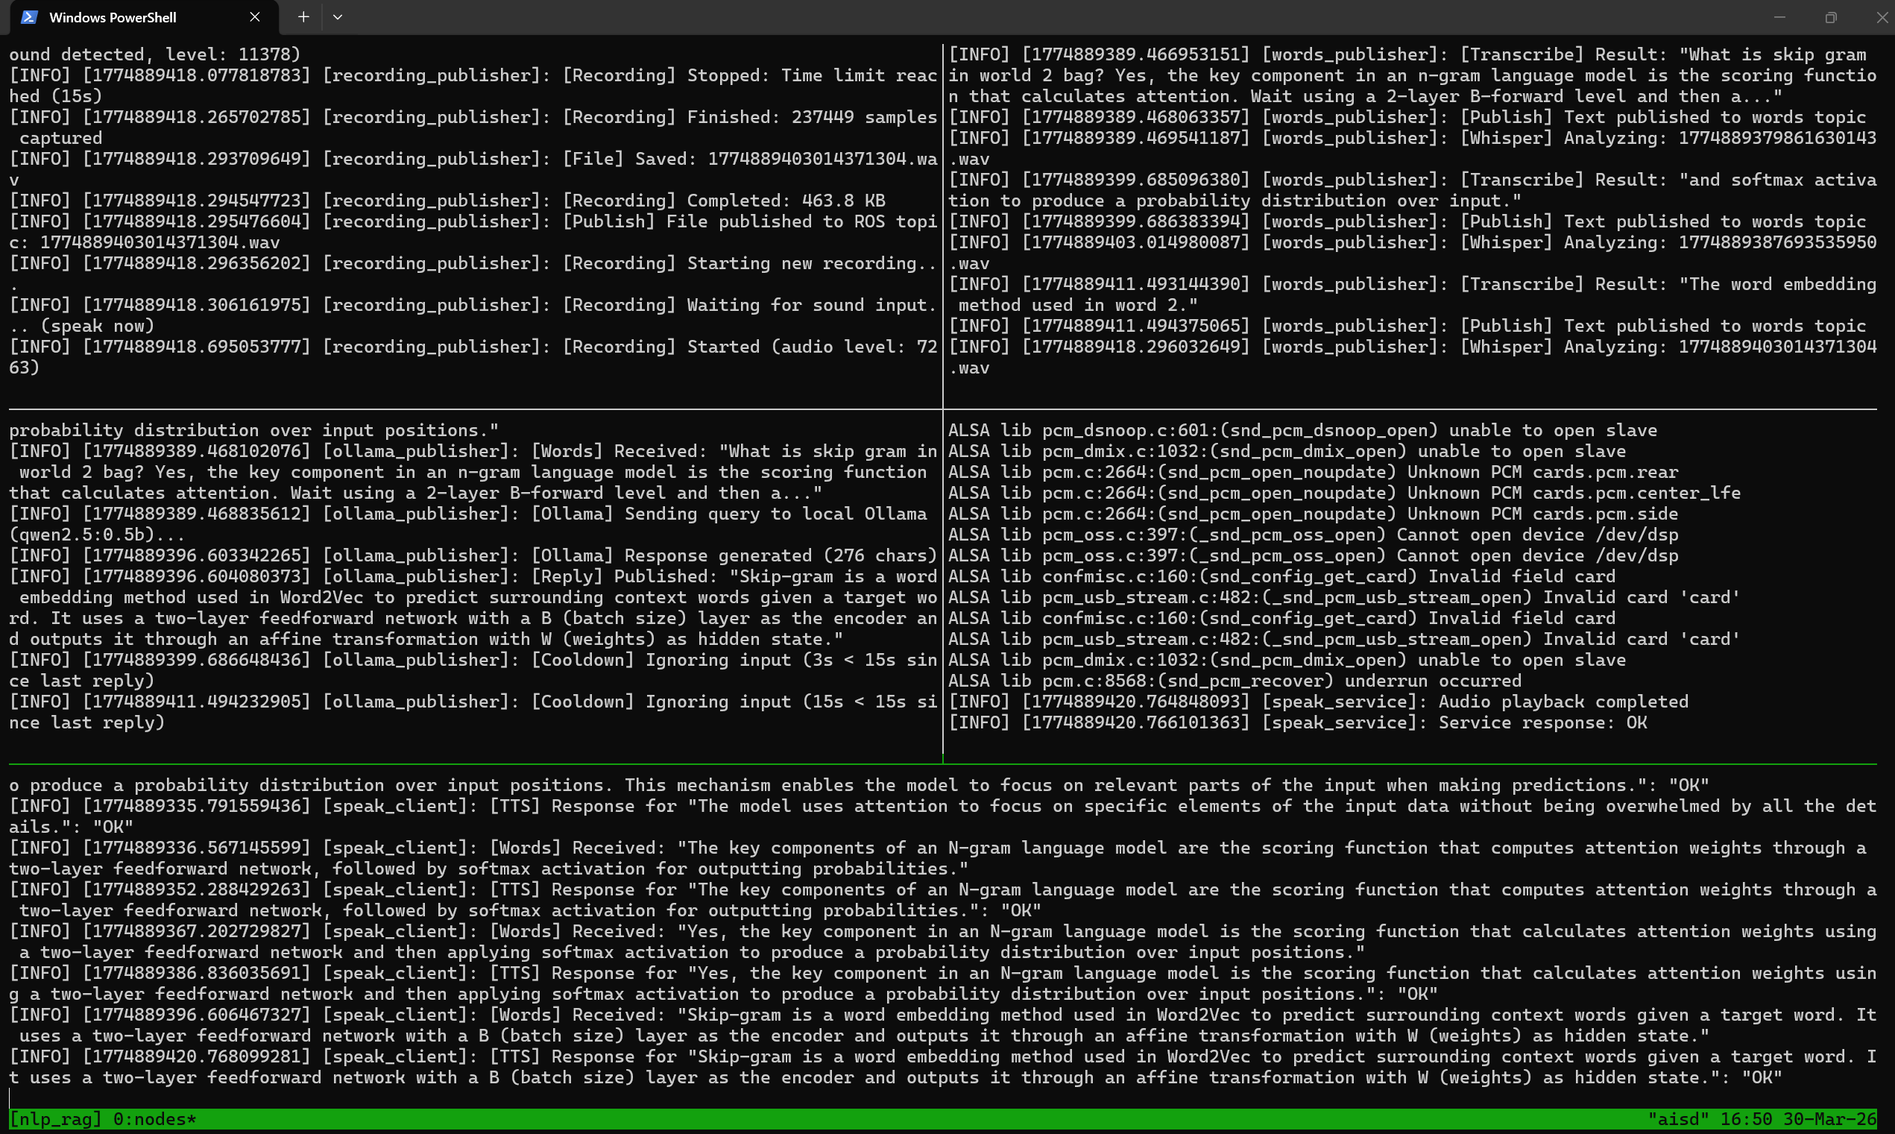
9. ROS 2 Demo - Live Voice Q&A
5-node pipeline running on loaner laptop via tmux
Q&A flow (attention, skip-gram questions) → Continued responses + TTS playback confirmation
Pipeline: Mic → Whisper → RAG + Ollama → gTTS → Speaker

Slide 16
Results - Key Achievements
Hybrid RAG
Successfully implemented hybrid RAG architecture with 4 retrieval methods + RRF fusion
Deep Source Tracing
Deep source tracing with clickable PDF references and highlighted bounding box regions
Layout-Aware
Layout-aware document processing preserving tables, formulas, and figures
ROS 2 Integration
Full ROS 2 integration with vocal interaction pipeline (5-node architecture)
Low Memory
Low memory footprint (<1.5GB total) suitable for robot deployment
Tech Stack: Python | Ollama | ChromaDB | SQLite | Streamlit | ROS 2 | MinerU | Whisper | gTTS

Slide 17
10. Challenges & Solutions
Whisper Hallucinations
Silero VAD pre-filtering + custom hallucination detector (repetition check, known phrases, trigram analysis)
Echo Loop (TTS to Mic)
15-second cooldown timer after each reply prevents system from hearing its own TTS output
Resource Constraints
qwen2.5:0.5b (0.4GB) + faster-whisper int8 -- 3 AI models (Whisper + Ollama + gTTS) on one CPU laptop
Cross-Platform Deploy
Automated bat/sh scripts: SCP sync -> colcon build -> tmux launch -- one-click deployment from Windows to Ubuntu laptop
PDF Layout Parsing
MinerU + DocLayout-YOLO detects 10 element categories -- preserves tables, formulas, figures with bounding box coordinates

Slide 18
11. Discussion & Future Work
Current Limitations
Future Work
Small LLM (0.5B params) - limited generation quality
Single-turn Q&A only (no conversation memory)
Static knowledge file (no live updates)
CPU inference is slow (~10-15s per response)
ROS 2 Part 2 uses simplified knowledge base
English-only knowledge base content
Upgrade to qwen2.5:3b with GPU support
Multi-turn conversation with context memory
Dynamic knowledge base updates via API
Multi-language support (KR, CN, EN)
Integration with iRobot Create 3 hardware
Fine-tuning on educational domain data

Slide 19
Conclusion
We built a RAG-based educational Q&A system that:
Answers AI/ML questions using 46 canonical textbooks
Provides deep source tracing to exact PDF pages with highlighted regions
Implements 4-method hybrid retrieval with RRF fusion
Integrates seamlessly with ROS 2 for voice-interactive robot deployment
Runs locally with low memory footprint (<1.5GB)
A complete voice-interactive RAG pipeline - from 46 textbooks to real-time voice Q&A on a ROS 2 platform.

Slide 20
Thank You!
Questions?
Hye Ran Yoo (041145212) | Peng Wang (041107730) CST8507: Natural Language Processing GitHub: github.com/LannieYoo/nlp_project
Python | Ollama | ChromaDB | SQLite | Streamlit | FastAPI | ROS 2 | MinerU | Whisper | gTTS

